Slide 1

Emergency chatbot
Mobile application
Supervised by: Dr.Samar Hesham

Slide 2
Agenda
01
02
03
04
05
Introduction
07
12
Demo Video
ML vs DL
Problem definition
08
Dataset
13
Application specification
Motivation
14
Flowchart
09
Methodology
General Idea
15
Use case diagram
10
Technology used
16
Sequence diagram
Related work
11
Functional and non-functional
17
Future work
06
objectives

Slide 3
Introduction
In daily life, we can distinguish things through our five senses, One of them is hearing which works like a defender.
According to the world health organization 1 in 4 people will live with some degree of hearing loss by 2050.
“HOH ”or hard of hearing term is referring to people with hearing loss from the mild to severe.

Slide 4
Problem definition
People who are HOH usually communicate through spoken language and visuals.
They need to be aware of the sounds of the surrounding events to improve their dealing with the world
With the development of science, applications may help the patients impaired to live a better and safer life.

Slide 5
Motivation
As a result of HOH case people can face many difficulties in their daily life like (fire, stealing, etc.), thus they crucially need a help.
Technology helps HOH with many ways, Assistive listening devices (ALDs), alerting devices, etc. which encouraged us to take a role.
One of these modern ways is providing an application that helps them to avoid difficulties which sounds attractive way.

Slide 6
General idea
This app will be like an assistant that can hear what the user maybe can’t hear.
Then notify him/her by simple notification, and by flashlight or/and vibration.
It will be like allowing your smart device to be turned into alerting device with Eara.
By alerting the user of sounds from his/her environment.
And for sure, getting alerts to sounds around you makes you feel safe, secure and comfort.

Slide 7
Related work

Slide 8
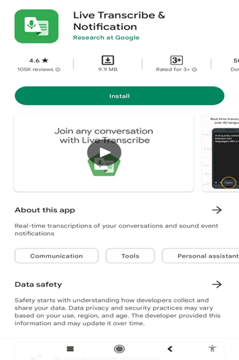
Related work
Google’s Live Transcribe
In real time, transcribes from 70 languages and dialects into text, and can switch between these languages in case of bilingual conversations. In addition, can recognize some specific custom sounds.

Slide 9
Related work (cont.)
Advantages
Easy To Use
Real-time feedback
Small Size
Support Android And Ios
Disadvantages
Dependence on internet connection.
Limited functionality.
Limited specified Language.
No option to backup transcribed script.

Slide 10
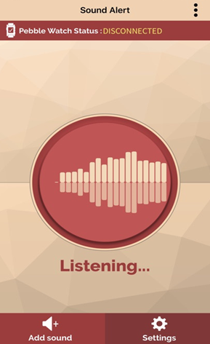
Related work (cont.)
Sound Alert
Sound Alert gives you the ability to record your environmental and home sounds to alert you in case of events which are important for you. But it is limited on iOS only

Slide 11
Related work (cont.)
Advantages
User can save records.
It can connect to other devices.
Medium size.
Disadvantages
Paying is a must for some features of the application.
Does not support Android.
Limitations of Connected devices.
It’s currently doesn’t work.
Server subscription problems.

Slide 12
Objectives

Slide 13
Objectives
Real time assistance - User Triage
Assessments of symptoms - integration with emergency
services
First aid guidelines - user education
Emergency contact information - cross – platform
Location based services - Natural language understanding

Slide 14
Machine vs deep learning?

Slide 15
Machine Learning | Deep learning
A subset of AI | A subset of machine learning
Can train on smaller data sets | Requires large amounts of data
Requires more human intervention to correct and learn | Learns on its own from environment and past mistakes
Shorter training and lower accuracy | Longer training and higher accuracy
Can train on a CPU (Central Processing Unit) | Needs a specialized GPU (Graphics Processing Unit) to train
Better for structured data that can be easily labeled, such as tabular data | Better for unstructured data or has a complex structure (images, videos, audio files, etc.)
Support supervised/unsupervised learning | Support supervised/unsupervised learning

Slide 16
Deep learning algorithms
There are different deep learning algorithms to solve different problems:
ANNs (Artificial Neural Networks): are helpful for solving complex problems.
CNNs (Convolution Neural Networks): are best for solving Computer Vision-related problems.
RNNs (Recurrent Neural Networks): are proficient in Natural Language Processing (NLP).

Slide 17
UrbanSound8K
This dataset contains 8732 labeled sound excerpts (<=4s) of urban sounds from 10 classes:
(air_conditioner, car_horn, children_playing, dog_bark, drilling, enginge_idling, gun_shot, jackhammer, siren, and street_music.)
In addition to the sound excerpts, a CSV file containing metadata about each excerpt is also provided.
These 8732 audio files of urban sounds in WAV format

Slide 18
Dataset

Slide 19
METHODOLOGY

Slide 20
Methodology(cont.)
We used CNN to classify our dataset and predict new sounds.
CNN gets =<90% accuracy higher than our last used model with about 5%
Librosa and MFCC in the preprocessing to standardize the features of the wav file
Define the architecture of the model
Define the prediction function

Slide 21
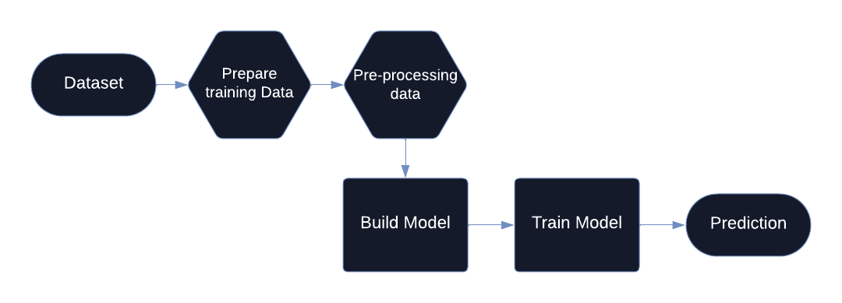
Methodology(cont.)

Slide 22
Technology used and libraries

Slide 23
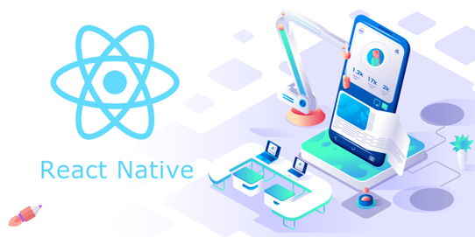
React naitive
React Native is a JavaScript framework for writing real, natively rendering mobile applications for iOS and Android.
React Native has been successfully adopted by hundreds of businesses worldwide, including Uber, Microsoft, and Facebook, and is used across a whole range of industries.

Slide 24
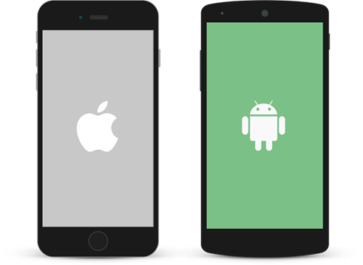
React naitive(cont.)
The Benefits of React Native for Mobile App Development :
Write once and use Everywhere
Open Source
Saves Time and Money
Large community Support
UI Focused
Live Reload

Slide 25
Functional and non-functional

Slide 26
Functional requirements
The chatbot will provide immediate responses to user queries related to medical emergencies.
It will assess and analyze user-provided symptoms to identify potential medical issues.
The chatbot will offer step-by-step first aid instructions for common medical emergencies.
It will provide information on emergency contacts, including local hospitals, clinics, and emergency services.
The chatbot will use geolocation services to identify the user's location and offer location-specific emergency services information.

Slide 27
Non-functional requirements
The chatbot will not replace professional medical advice, diagnosis, or treatment.
It will not store sensitive user data beyond the duration of the session, and all interactions will comply with data privacy regulations.
The chatbot will not provide information on controlled substances, prescription medications, or any content that requires professional medical expertise.

Slide 28
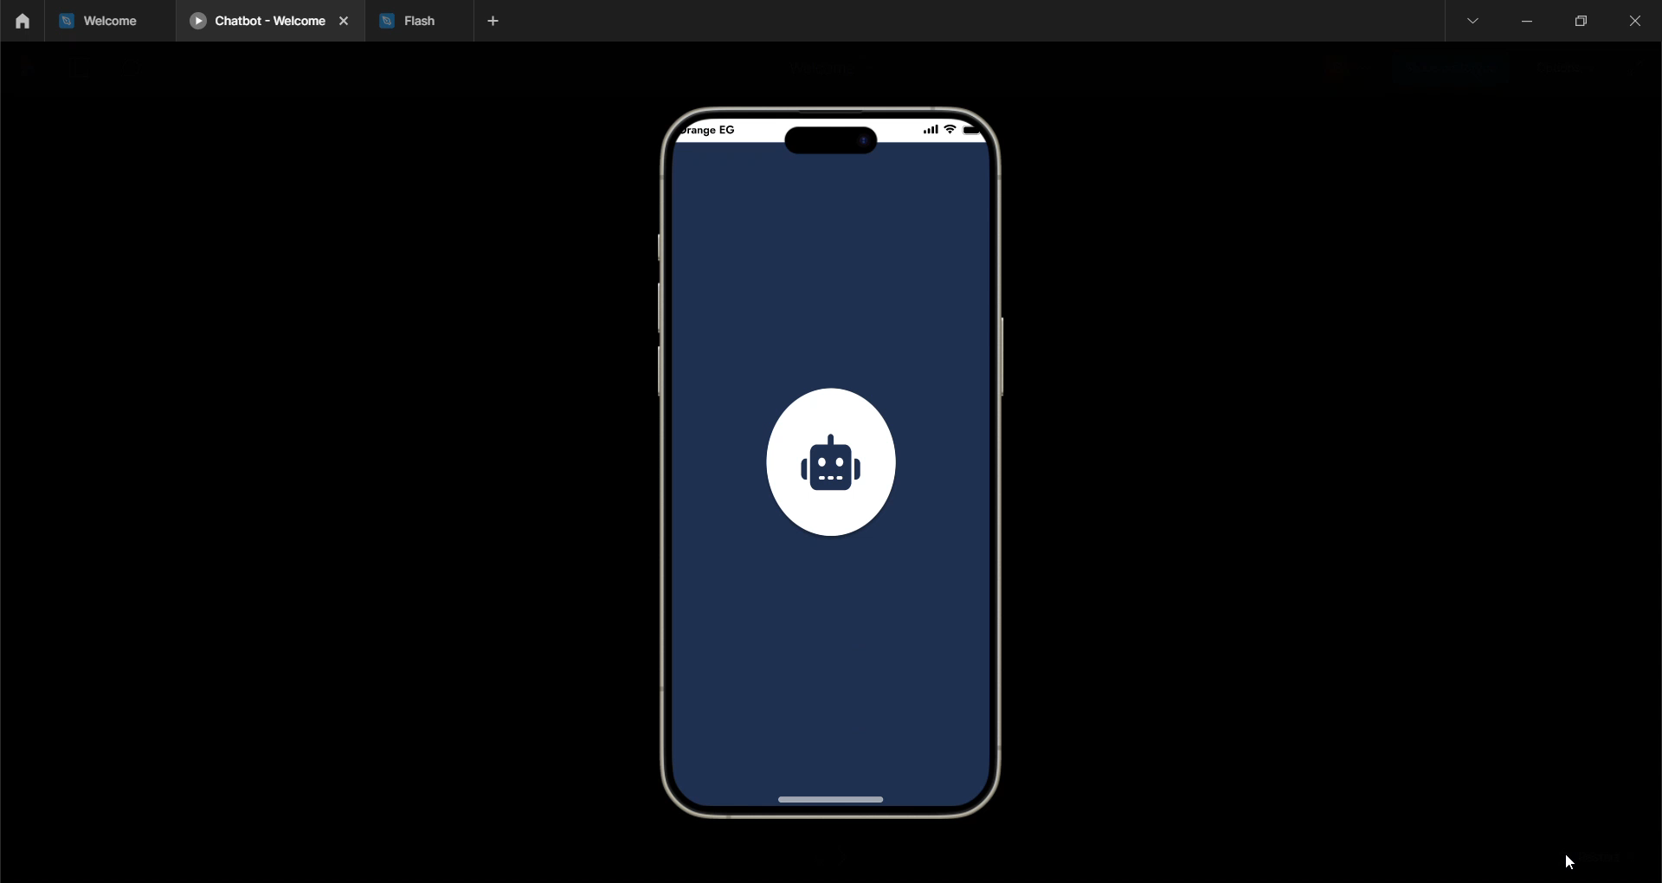
Demo Video

Slide 29
Application specification

Slide 30
Application specification
Usability
reliability
Portability
compatibility
Availability

Slide 31
Application Speciation
Chatting
Emergency calls
Translation
Location to nearby hospitals

Slide 32
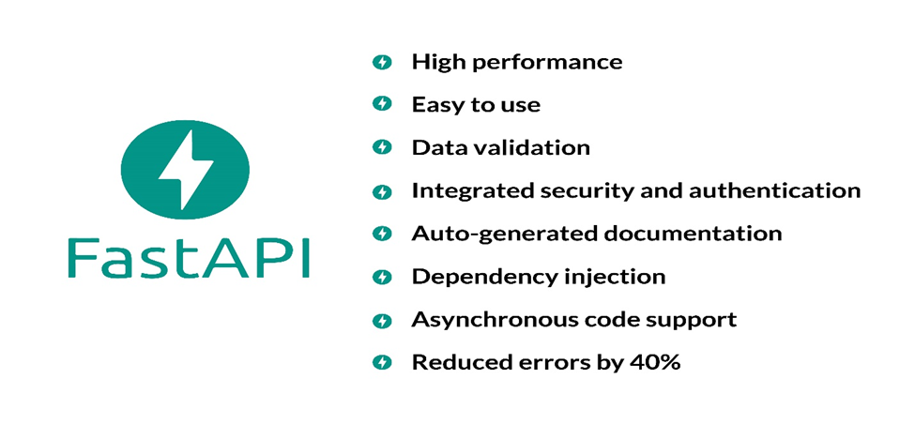
Why FastAPI

Slide 33
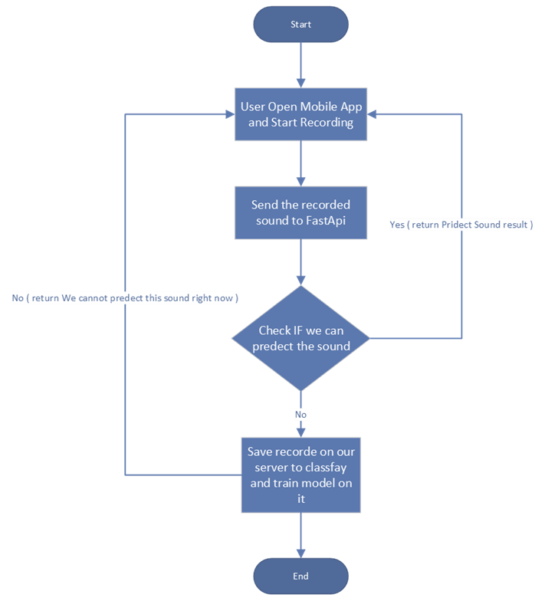
Flowchart

Slide 34
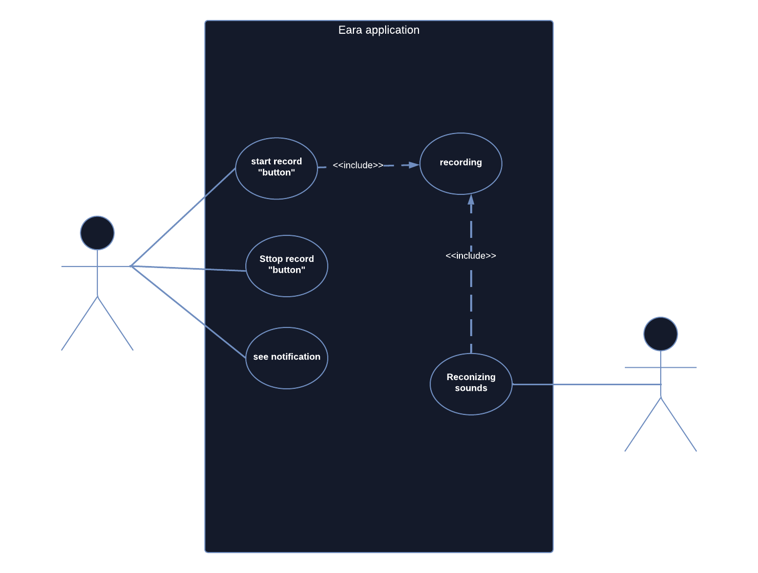
Usecase diagram

Slide 35
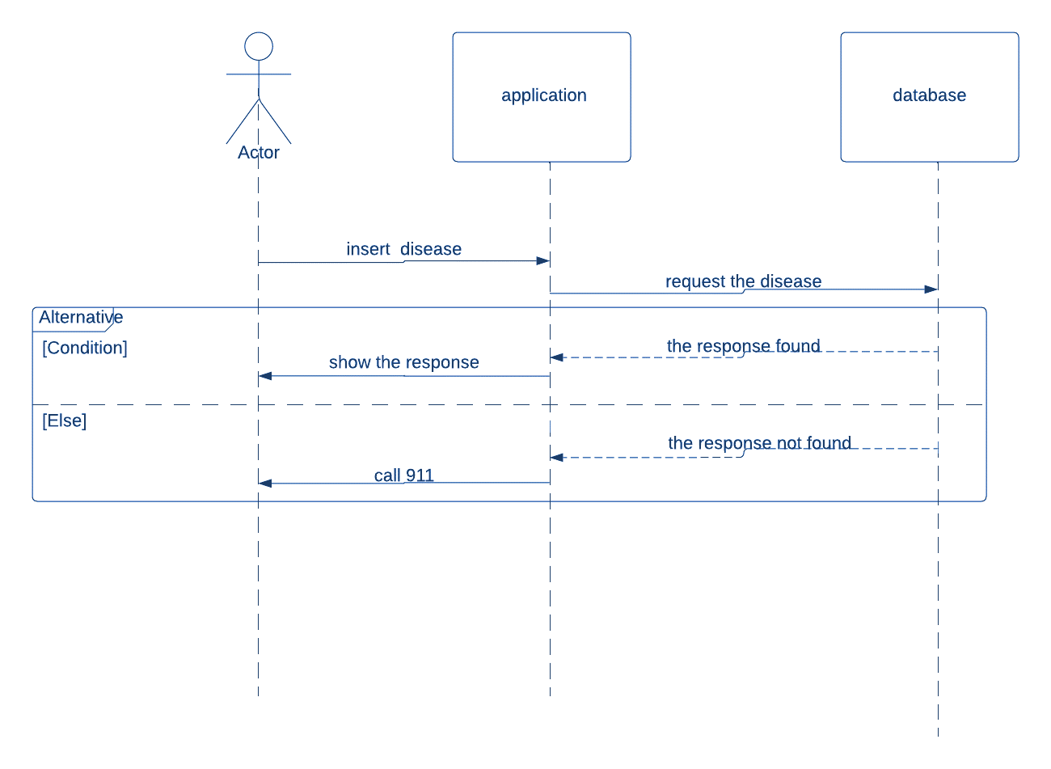
Sequence Diagram

Slide 36
Thank you
Dr. Samar Hesham

